Slide 1
Neural Network Fundamentals
Backpropagation
Lecture 3
Part 3
Generative AI for Computer Vision

Slide 2
Content
Feed Forward Neural Network
Notations
Training of the Neural Network
  Forward Pass
  Backward Pass (Backpropagation)
Training of the Neural Network: 4 Layers Neural Network
Computational Complexity of the Training
Space Complexity

Slide 3













Feed Forward Neural Network
Input Layer (Layer 0)
Acts as the gateway to the neural network.
Receives the input features and passes them to the subsequent layers without performing any computation.
Hidden Layers (Layers 1 to k)
Extract and learn meaningful patterns from the input data.
Early hidden layers identify basic and low-level features.
Deeper hidden layers progressively combine these features to capture higher-level and more abstract representations.
Output Layer (Layer k+1)
Produces the final prediction or decision of the network.
Applies an appropriate activation function to generate the desired output.
$$I_{0}$$
$$I_{1}$$
$$I_{l}$$
$$I_{n}$$
Input Layer (Layer 0)
$$h_{11}$$
$$h_{1e}$$
$$h_{1m}$$
Hidden Layer with n No. of neurons
1 to k no. of hidden layers
$$w_{ei}$$
$$h_{k1}$$
$$h_{ki}$$
$$h_{kr}$$
Hidden Layer with r No. of neurons
$$Y_{1}$$
$$Y_{2}$$
Output Layer(k+1)

Slide 4



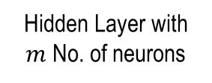





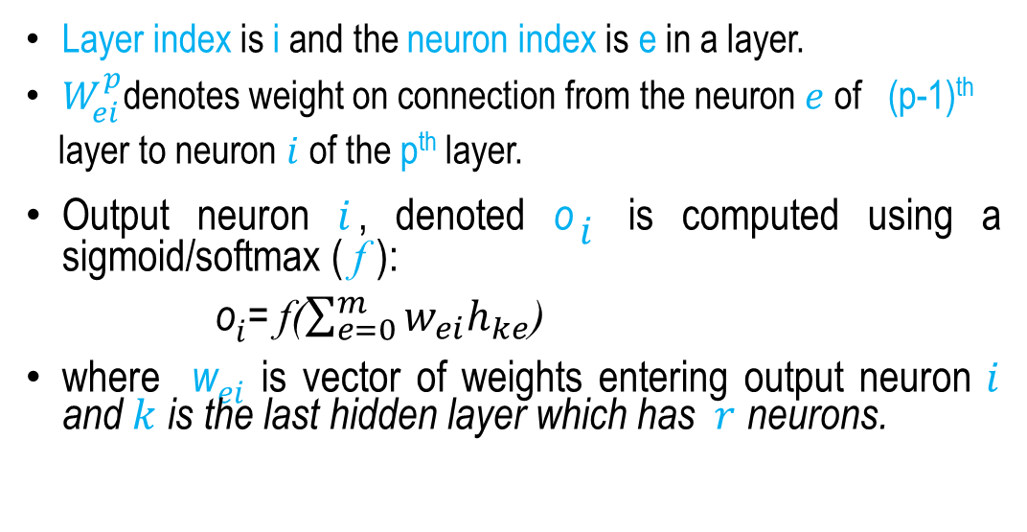














Feed forward Neural Network (Notations)
Layer index is i and the neuron index is e in a layer.
$W_{ei}^{p}$denotes weight on connection from the neuron $e$ of (p-1)^{th}
layer to neuron $i$ of the p^{th} layer.
Output neuron $i$, denoted o$i$ is computed using a sigmoid/softmax ( f ):
o$i$= f($\sum_{e=0}^{m}{w_{ei}h_{ke}}$)
where w$ei$ is vector of weights entering output neuron $i$ and $k$ is the last hidden layer which has $r$ neurons.
$$I_{0}$$
$$I_{1}$$
$$I_{e}$$
$$I_{n}$$
Input Layer
$$h_{11}$$
$$h_{1e}$$
$$h_{1m}$$
Hidden Layer with $m$ No. of neurons
$$w_{ei}$$
k no. of hidden layers
$$h_{k1}$$
$$h_{ki}$$
$$h_{kr}$$
Hidden Layer with r No. of neurons
$$w_{11}$$
$$w_{r1}$$
$$Y_{1}$$
$$Y_{2}$$
Output Layer
(p-1)^{th} Layer
$$h_{p−11}$$
$$h_{p−1e}$$
$$h_{p−1m}$$
Now the questions are:
Given an input, how do we compute the output?
How do we get the weights?
$$w_{ei}^{p}$$
p^{th} Layer
$$h_{p 1}$$
$$h_{p i}$$
$$h_{p r}$$

Slide 5
Training of The Neural Network
Backpropagation is the fundamental learning algorithm used to train neural networks. It efficiently determines how each weight in the network should be updated to minimize the prediction error.
The process begins when the neural network makes a prediction. This prediction is compared with the actual target value, and the difference between them is measured using a loss (error) functions.
Backpropagation tells us:
  How much did each weight contribute to that error?
  Once we know that, we can adjust the weights to improve the network.

Slide 6
Training of The Neural Network
Backpropagation consists of two main phases:
Forward Pass
Input data is passed through the network.
In each hidden layer, weighted inputs are summed and a non-linear activation function is applied.
The output of one layer becomes the input to the next layer.
The network produces a final prediction.
The loss (error) is computed using a loss function such as Mean Squared Error (MSE) or Cross-Entropy.
Backward Pass (Backpropagation)
The error is propagated backward from the output layer to the input layer.
Gradients are calculated using the chain rule.
Each weight receives a gradient indicating how much a change in that weight would affect the loss.

Slide 7




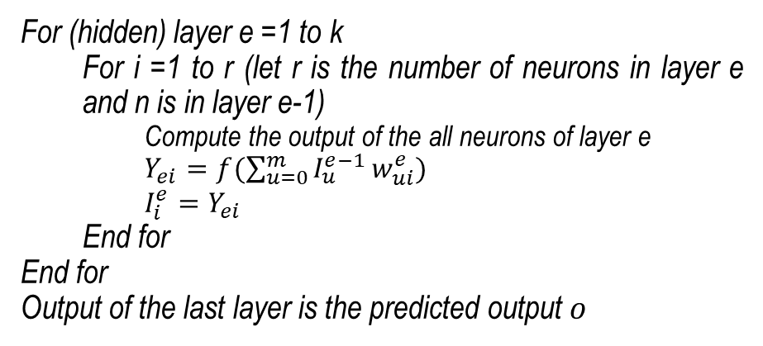





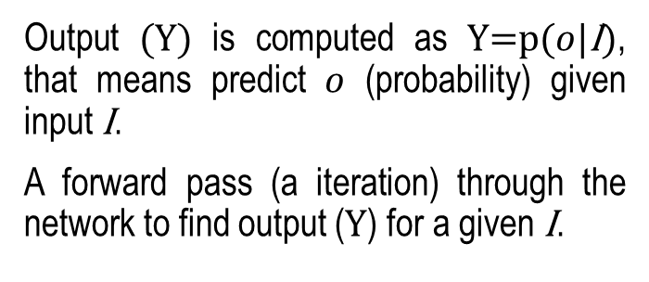










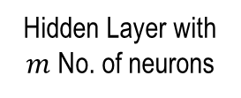



Computation of the MLP Output
For (hidden) layer e =1 to k
  For i =1 to r (let r is the number of neurons in layer e and n is in layer e-1)
    Compute the output of the all neurons of layer e
    $Y_{ei}=f(\sum_{u=0}^{m}{I_{u}^{e−1}}w_{ui}^{e})$
    $$I_{i}^{e}=Y_{ei}$$
  End for
End for
Output of the last layer is the predicted output $o$
Output (Y) is computed as Y=p($o$|I), that means predict $o$ (probability) given input I.
A forward pass (a iteration) through the network to find output (Y) for a given I.
$$I_{0}$$
$$I_{1}$$
$$I_{l}$$
$$I_{n}$$
Input Layer
$$h_{11}$$
$$h_{1e}$$
$$h_{1m}$$
Hidden Layer with $m$ No. of neurons
(p-1)^{th} Layer
$$h_{p−11}$$
$$h_{p−1e}$$
$$h_{p−1m}$$
$$w_{ei}$$
k no. of hidden layers
$$h_{k1}$$
$$h_{ki}$$
$$h_{kr}$$
Hidden Layer with r No. of neurons
$$w_{ei}^{p}$$
$$w_{11}$$
$$w_{r1}$$
p^{th} Layer
$$h_{p 1}$$
$$h_{p i}$$
$$h_{p r}$$
$$Y_{1}$$
$$Y_{2}$$
Output Layer

Slide 8








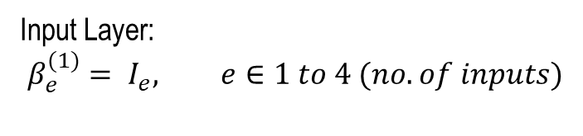















Forward Pass
  4 Layers Neural Network
  (One Input Layer, two Hidden Layers and one Output Layers)
$$I_{1}$$
$$I_{2}$$
$$I_{3}$$
$$I_{4}$$
Input Layer:
$$β_{e}^{(1)}= I_{e}, e∈1 to 4 (no. of inputs)$$
$$β_{1}^{(0)}$$
$$β_{2}^{(0)}$$
$$β_{3}^{(0)}$$
$$β_{4}^{(0)}$$
Input Layer
$$W_{1}^{(1)}{,b}^{(1)}$$
$$s_{1}^{(1)}$$
$$s_{2}^{(1)}$$
$$W_{2}^{(1)}{,b}^{(1)}$$
Hidden Layer 1
$$f_{h}$$
$$β_{1}^{(1)}$$
$$β_{2}^{(1)}$$
$$f_{h}$$
$$W_{1}^{(2)}{,b}^{(2)}$$
$$s_{1}^{(1)}$$
$$s_{2}^{(1)}$$
$$W_{2}^{(2)}{,b}^{(2)}$$
Hidden Layer 2
$$f_{h}$$
$$β_{1}^{(1)}$$
$$β_{2}^{(1)}$$
$$f_{h}$$
$$W^{(3)}$$
$$f_{Y}$$
Output Layer
$$Y$$
Input layer’s neurons copy to inputs to the next layers.

Slide 9



























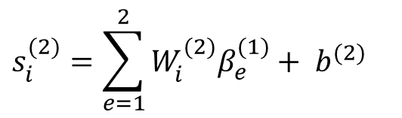
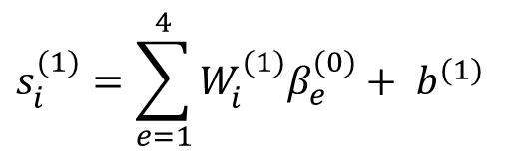
Forward Pass
  4 Layers Neural Network
  (One Input Layer, two Hidden Layers and one Output Layers)
$$I_{1}$$
$$I_{2}$$
$$I_{3}$$
$$I_{4}$$
$$s_{i}^{(1)}=\sum_{e=1}^{4}{W_{i}^{(1)}β_{e}^{(0)}+ b^{(1)}}$$
Hidden Layer 1:
$$β_{1}^{(0)}$$
$$β_{2}^{(0)}$$
$$β_{3}^{(0)}$$
$$β_{4}^{(0)}$$
Input Layer
$$e∈1 to 4 (no. of inputs to 1st Hidden Layer)$$
$$i∈1 to 2 (no. of neurons in first hidden layer)$$
$$W_{1}^{(1)}{,b}^{(1)}$$
$$s_{1}^{(1)}$$
$$s_{2}^{(1)}$$
$$W_{2}^{(1)}{,b}^{(1)}$$
Hidden Layer 1
$$β_{i}^{(1)}=f_{h}(s_{i}^{\left(1\right)})$$
$$β_{1}^{(1)}$$
$$β_{2}^{(1)}$$
$$f_{h}$$
$$f_{h}$$
$$f_{h}:activation function for hidden layers$$
$$W_{1}^{(2)}{,b}^{(2)}$$
$$s_{1}^{(1)}$$
$$s_{2}^{(1)}$$
$$W_{2}^{(2)}{,b}^{(2)}$$
$$s_{i}^{(2)}=\sum_{e=1}^{2}{W_{i}^{(2)}β_{e}^{(1)}+ b^{(2)}}$$
Hidden Layer 2
Hidden Layer 2:
$$f_{h}$$
$$β_{1}^{(1)}$$
$$β_{2}^{(1)}$$
$$f_{h}$$
$$W^{(3)}$$
$$e∈1 to 2 (no. of inputs to 2nd Hidden Layer)$$
$$f_{Y}$$
Output Layer
$$i∈1 to 2 (no. of neurons in 2nd hidden layer)$$
$$β_{i}^{(2)}=f_{h}(s_{i}^{\left(2\right)})$$
$$Y$$
$$f_{h}:activation function for hidden layers$$
Input layer’s neurons copy to inputs to the next layers.

Slide 10


















Forward Pass
  4 Layers Neural Network
  (One Input Layer, two Hidden Layers and one Output Layers)
$$I_{1}$$
$$I_{2}$$
$$I_{3}$$
$$I_{4}$$
$$β_{1}^{(0)}$$
$$β_{2}^{(0)}$$
$$β_{3}^{(0)}$$
$$β_{4}^{(0)}$$
Input Layer
$$W_{1}^{(1)}{,b}^{(1)}$$
$$s_{1}^{(1)}$$
$$s_{2}^{(1)}$$
$$W_{2}^{(1)}{,b}^{(1)}$$
$$Y=f_{Y}(\sum_{e=1}^{2}{W^{(3)}β_{e}^{(2)})}$$
Hidden Layer 1
$$f_{h}$$
$$β_{1}^{(1)}$$
$$β_{2}^{(1)}$$
$$f_{h}$$
$$W_{1}^{(2)}{,b}^{(2)}$$
$$s_{1}^{(1)}$$
$$s_{2}^{(1)}$$
$$W_{2}^{(2)}{,b}^{(2)}$$
$$f_{Y}:activation function for output layer$$
Hidden Layer 2
$$f_{h}$$
$$β_{1}^{(1)}$$
$$β_{2}^{(1)}$$
$$f_{h}$$
$$W^{(3)}$$
$$f_{Y}$$
Output Layer
$$Y$$
Input layer’s neurons copy to inputs to the next layers.

Slide 11















Backward Pass : Backpropagation
Backpropagation minimizes the cost (loss) function by updating the network's weights and biases using an optimization algorithm such as gradient descent.
The error gradient with help of learning rate indicates how much each parameter should be changed, and in which direction, to reduce the loss.
During backpropagation, these gradients are propagated from the output layer back to the input layer, hence the name backpropagation.
Gradients are computed directly at the output layer and then propagated through the hidden layers using the chain rule of calculus.
Forward Pass
$$I_{0}$$
$$I_{1}$$
$$I_{l}$$
$$I_{n}$$
Input Layer
$$h_{11}$$
$$h_{1e}$$
$$h_{1m}$$
Hidden Layer with m No. of neurons
Backward Pass: Backpropagation
$$w_{ei}$$
k no. of hidden layers
$$h_{k1}$$
$$h_{ki}$$
$$h_{kr}$$
Hidden Layer with r No. of neurons
$$w_{11}$$
$$w_{r1}$$
$$Y_{1}$$
$$Y_{2}$$
Output Layer

Slide 12



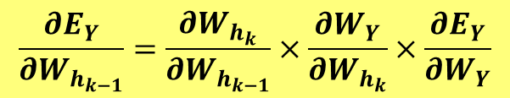














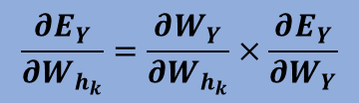












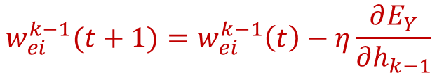
Backpropagation : Algorithm
$$W_{h_{1}}$$
$$h_{1}$$
$$h_{11}$$
$$h_{1e}$$
$$h_{1n}$$
$$W_{h_{2}}$$
$$\frac{∂E_{Y}}{∂W_{h_{1}}}=\frac{∂W_{h_{2}}}{∂W_{h_{1}}}×\frac{∂W_{h_{3}}}{∂W_{h_{2}}}×…×\frac{∂W_{h_{k}}}{∂W_{h_{k−1}}}×\frac{∂W_{Y}}{∂W_{h_{k}}}×\frac{∂E_{Y}}{∂W_{Y}}$$
$$h_{2}$$
$$h_{21}$$
$$h_{2e}$$
$$h_{2n}$$
$$W_{h_{3}}$$
$$\frac{∂E_{Y}}{∂W_{h_{2}}}=\frac{∂W_{h_{3}}}{∂W_{h_{2}}}×…×\frac{∂W_{h_{k}}}{∂W_{h_{k−1}}}×\frac{∂W_{Y}}{∂W_{h_{k}}}×\frac{∂E_{Y}}{∂W_{Y}}$$
$$W_{h_{k−1}}$$
$$h_{k−1}$$
$$h_{k−11}$$
$$h_{k−1e}$$
$$h_{k−1n}$$
$$\frac{∂E_{Y}}{∂W_{h_{k−1}}}=\frac{∂W_{h_{k}}}{∂W_{h_{k−1}}}×\frac{∂W_{Y}}{∂W_{h_{k}}}×\frac{∂E_{Y}}{∂W_{Y}}$$
$$W_{h_{k}}$$
$$h_{k}$$
$$h_{k1}$$
$$h_{ke}$$
$$h_{kn}$$
$$\frac{∂E_{Y}}{∂W_{h_{k}}}=\frac{∂W_{Y}}{∂W_{h_{k}}}×\frac{∂E_{Y}}{∂W_{Y}}$$
$$W_{Y}$$
$$w_{ei}^{k−1}(t+1)=w_{ei}^{k−1}\left(t\right)−η\frac{∂E_{Y}}{∂h_{k−1}}$$
$$Y_{1}$$
$$Y_{2}$$
$$Y_{p}$$
$$E=\frac{1}{2}{(D−d)}^{2}$$
$$\frac{∂E_{Y}}{∂W_{Y}}$$
Weight Updation in a Backward direction (Backpropagation) using chain rule

Slide 13
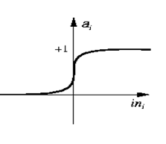

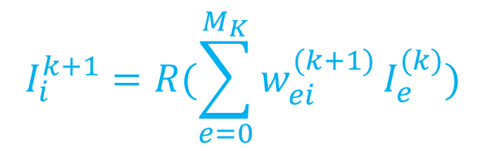
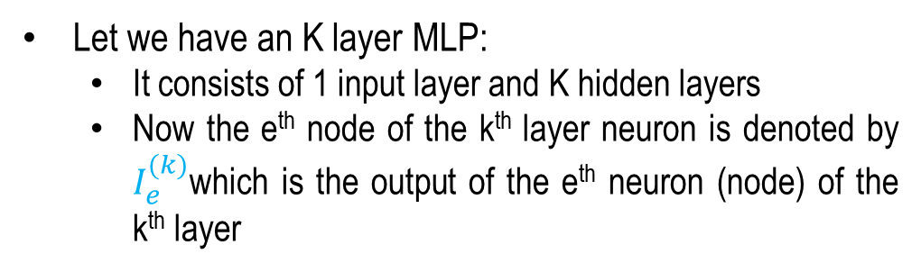
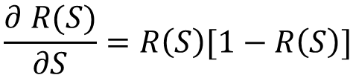
Backpropagation : Algorithm
Sigmoidal Non-linearity
Let we have an K layer MLP:
  It consists of 1 input layer and K hidden layers
  Now the e^{th} node of the k^{th} layer neuron is denoted by $I_{e}^{(k)}$which is the output of the e^{th} neuron (node) of the k^{th} layer
$R(S)$= $\frac{1}{1+e^{−s}}$
$$\frac{∂ R(S)}{∂S}=R\left(S\right)[1−R\left(S\right)]$$
$$I_{i}^{k+1}=R(\sum_{e=0}^{M_{K}}{w_{ei}^{(k+1)}}I_{e}^{(k)})$$
where $M_{K }$ is the number of nodes in the kth hidden layer.

Slide 14
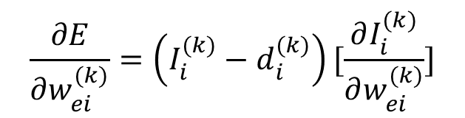
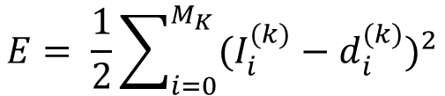

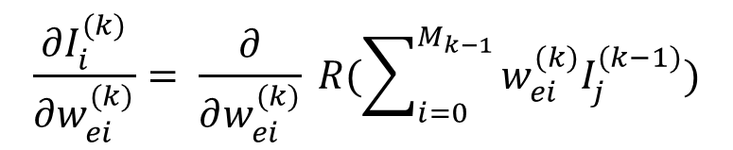
Backpropagation : Algorithm
$$E= \frac{1}{2}\sum_{i=0}^{M_{K}}{{(I_{i}^{(k)}−d_{i}^{(k)})}^{2}}$$
Error:
at output layer
$$\frac{∂E}{∂w_{ei}^{(k)}}=\left(I_{i}^{(k)}−d_{i}^{(k)}\right)[\frac{∂I_{i}^{(k)}}{∂w_{ei}^{(k)}}]$$
$$\frac{∂I_{i}^{(k)}}{∂w_{ei}^{(k)}}= \frac{∂}{∂w_{ei}^{(k)}} R(\sum_{i=0}^{M_{k−1}}{w_{ei}^{(k)}I_{j}^{(k−1)}})$$
Now,
After Some Algebraic
Manipulations
= $I_{i}^{(k)}(1−I_{i}^{(k)})I_{e}^{(k−1)}$

Slide 15
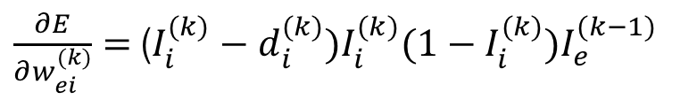
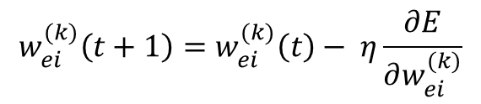


Backpropagation : Algorithm
$\frac{∂E}{∂w_{ei}^{(k)}}=$($I_{i}^{(k)}−d_{i}^{(k)})I_{i}^{(k)}(1−I_{i}^{(k)})I_{e}^{(k−1)}$
at output layer
So the weight updation step at output layer is follows:
$$w_{ei}^{(k)}\left(t+1\right)=w_{ei}^{(k)}\left(t\right)− η\frac{∂E}{∂w_{ei}^{(k)}}$$
$$δ_{i}^{(k)}$$
$$w_{ei}^{(k)}\left(t+1\right)=w_{ei}^{(k)}\left(t\right)− η(I_{i}^{(k)}−d_{i}^{(k)})I_{i}^{(k)}(1−I_{i}^{(k)})I_{e}^{(k−1)}$$
Thus the error is propagated from output to input layer. So the name “Backpropagation Algorithm.”
$$w_{ei}^{(k)}\left(t+1\right)=w_{ei}^{(k)}\left(t\right)− ηδ_{i}^{(k)}I_{e}^{(k−1)}$$
at output layer
Feed forward Backpropagation Algorithm

Slide 16
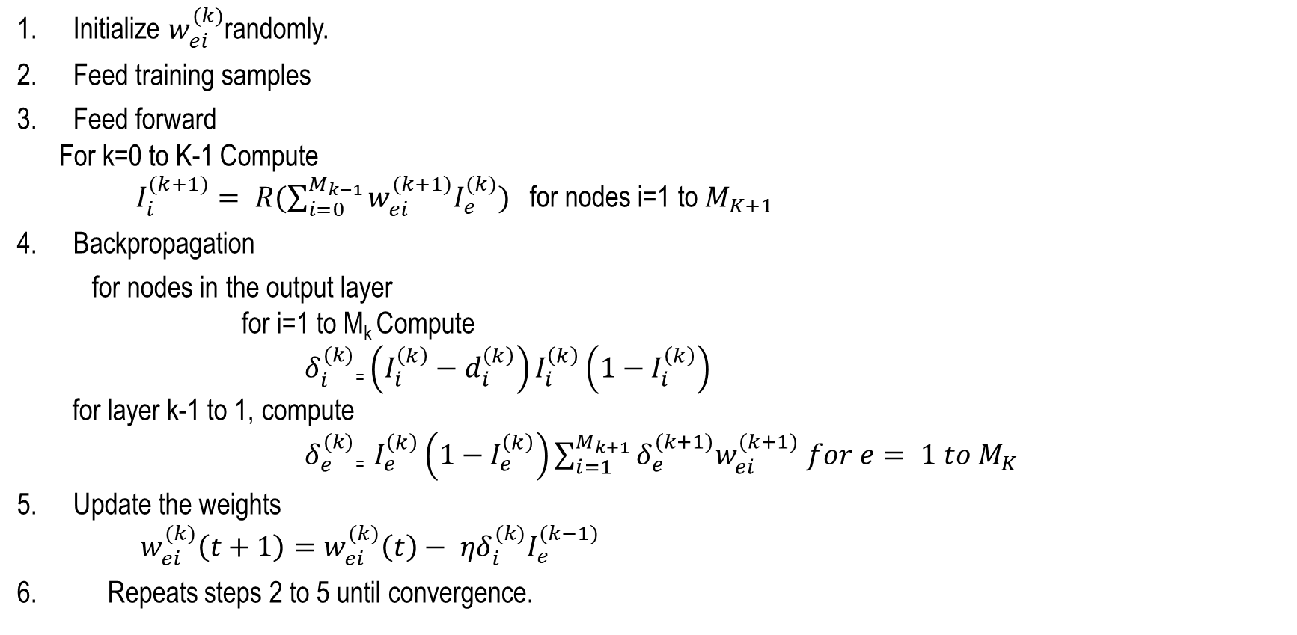
Backpropagation : Algorithm
Initialize $w_{ei}^{(k)}$randomly.
Feed training samples
Feed forward
  For k=0 to K-1 Compute
    $I_{i}^{(k+1)}= R(\sum_{i=0}^{M_{k−1}}{w_{ei}^{(k+1)}I_{e}^{(k)})}$ for nodes i=1 to $M_{K+1}$
Backpropagation
for nodes in the output layer
  for i=1 to M_{k} Compute
  $δ_{i}^{(k)}$₌ $\left(I_{i}^{\left(k\right)}−d_{i}^{\left(k\right)}\right)I_{i}^{\left(k\right)}\left(1−I_{i}^{\left(k\right)}\right)$
  for layer k-1 to 1, compute
  $δ_{e}^{(k)}$₌ $I_{e}^{\left(k\right)}\left(1−I_{e}^{\left(k\right)}\right)\sum_{i=1}^{M_{k+1}}{δ_{e}^{(k+1)}w_{ei}^{(k+1)}}$ $for e= 1 to M_{K}$
Update the weights
  $w_{ei}^{(k)}\left(t+1\right)=w_{ei}^{(k)}\left(t\right)− ηδ_{i}^{(k)}I_{e}^{(k−1)}$
Repeats steps 2 to 5 until convergence.

Slide 17


























Example of Backpropagation
Loss:
$$I_{1}$$
$$I_{2}$$
$$I_{3}$$
$$I_{4}$$
$$E_{Y}=\frac{1}{2}{(D−d)}^{2}$$
$$β_{1}^{(0)}$$
$$β_{2}^{(0)}$$
$$β_{3}^{(0)}$$
$$β_{4}^{(0)}$$
Input Layer
where D is target value and d is the predicted value
Gradient of Loss at Output Layer with respect to the output layer weight parameters
$$\frac{∂E_{Y}}{∂h_{1}}$$
$$W_{1}^{(1)}{,b}^{(1)}$$
$$s_{1}^{(1)}$$
$$s_{2}^{(1)}$$
$$W_{2}^{(1)}{,b}^{(1)}$$
Hidden Layer 1
$$\frac{∂E_{Y}}{∂W_{Y}}$$
$$f_{h}$$
$$β_{1}^{(1)}$$
$$β_{2}^{(1)}$$
$$f_{h}$$
Gradient of Loss at Hidden Layer 2 with respect to corresponding weight parameters
$$W_{1}^{(2)}{,b}^{(2)}$$
$$W_{2}^{(2)}{,b}^{(2)}$$
$$s_{1}^{(1)}$$
$$s_{2}^{(1)}$$
Hidden Layer 2
$$\frac{∂E_{Y}}{∂W_{h_{2}}}=\frac{∂W_{Y}}{∂W_{h_{2}}}×\frac{∂E_{Y}}{∂W_{Y}}$$
$$\frac{∂E_{Y}}{∂h_{2}}$$
$$f_{h}$$
$$β_{1}^{(1)}$$
$$β_{2}^{(1)}$$
$$f_{h}$$
$$W^{(3)}$$
Gradient of Loss at Hidden Layer 1with respect to corresponding weight parameters
$$f_{Y}$$
Output Layer
$$Y$$
$$\frac{∂E_{Y}}{∂W_{h_{1}}}=\frac{∂W_{h_{2}}}{∂W_{h_{1}}}×\frac{∂W_{Y}}{∂W_{h_{2}}}×\frac{∂E_{Y}}{∂W_{Y}}$$
Loss
$$E_{Y}= \frac{1}{2}{(D−d)}^{2}$$
$$\frac{∂E_{Y}}{∂W_{Y}}$$

Slide 18
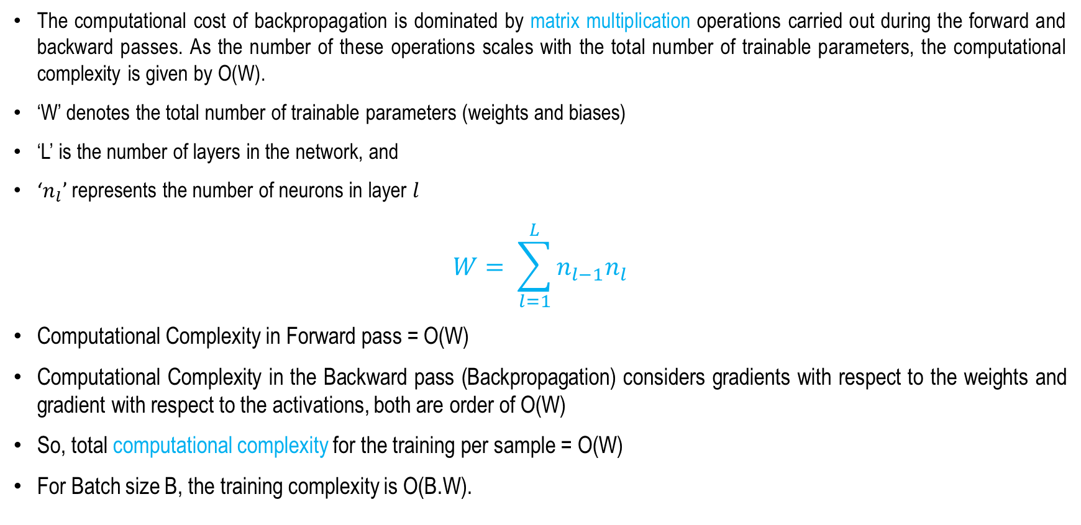
Backpropagation
Computational complexity
The computational cost of backpropagation is dominated by matrix multiplication operations carried out during the forward and backward passes. As the number of these operations scales with the total number of trainable parameters, the computational complexity is given by O(W).
‘W’ denotes the total number of trainable parameters (weights and biases)
‘L’ is the number of layers in the network, and
‘$n_{l}$’ represents the number of neurons in layer $l$
$$W= \sum_{l=1}^{L}{n_{l−1}n_{l}}$$
Computational Complexity in Forward pass = O(W)
Computational Complexity in the Backward pass (Backpropagation) considers gradients with respect to the weights and gradient with respect to the activations, both are order of O(W)
So, total computational complexity for the training per sample = O(W)
For Batch size B, the training complexity is O(B.W).

Slide 19
Backpropagation
Space Complexity
The space complexity of backpropagation is determined by the memory required to store the model parameters, intermediate activations, and gradients during training.
Storing Model Parameters: The weights and biases of the network are stored throughout training. If W is the total number of trainable parameters, the required memory is O(W).
Storing Intermediate Activations: The output activations of each layer are cached during the forward pass for use in gradient computation during backpropagation. The memory required grows linearly with the number of layers and neurons.
Storing Gradients: Backpropagation stores the gradient corresponding to each trainable parameter. Since there is one gradient per weight and bias, the memory required is O(W).
Overall Space Complexity: The overall space complexity is O(W), with additional memory required for storing intermediate activations during training.

Slide 20
Backpropagation
Space Complexity (Optimization : Checkpointing)
Standard implementation requires O(N) space to store activations. Checkpointing (or selective re-computation) trades computation time for reduced memory usage.
Standard approach (O(N) space): Store all intermediate activations during the forward pass. Fast computation but high memory usage.
Re-computation approach (O(1) space, O(N²) time): Recompute activations during the backward pass instead of storing them. Minimizes memory usage but increases computation time.
Checkpointing: Store only selected activations and recompute the rest as needed. Balances memory and computation, with space complexity between O(1) and O(N).

Slide 21
Summary
Feed Forward Neural Network
Notations
Training of the Neural Network
  Forward Pass
  Backward Pass (Backpropagation)
Training of the Neural Network: 4 Layers Neural Network
Computational Complexity of the Training
Space Complexity

Slide 22
Optimizing Supervised Model
Next
Lecture 3: Part 4
Generative AI for Computer Vision

